Slide 1
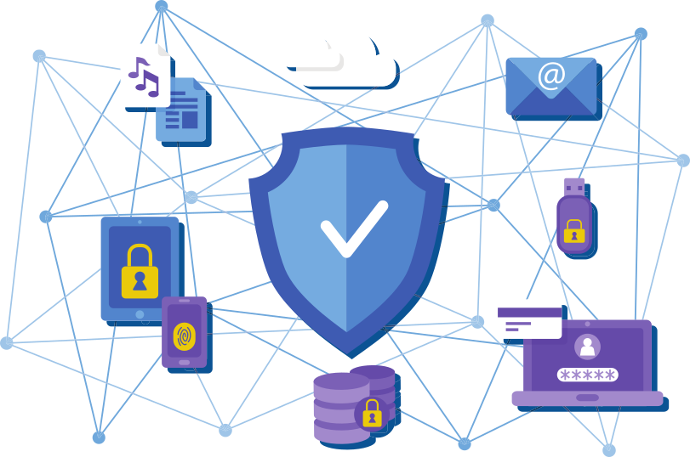


Privacy in the Age of IoT
Sayak Sarkar
Senior Software Engineer
Red Hat Inc.
@sayak_sarkar
https://sayak.in
*Image vectors sourced from: https://www.freepik.com
Notes:
Hey Everyone!
My name is Sayak Sarkar and I work as a Senior Software Engineer at Red Hat!
Professionally, I mostly dabble with Web & Cloud Technologies however, outside the professional realm, I’m an Open Source enthusiast and a privacy evangelist with an eye towards shiny new emerging tech in both the hardware and software world!
Today I would be talking about a subject that has been the topic of much debate in the recent few years and one that deserves a healthy bit of conversation, and the topic is Privacy in the Age of the Internet of Things!

Slide 2
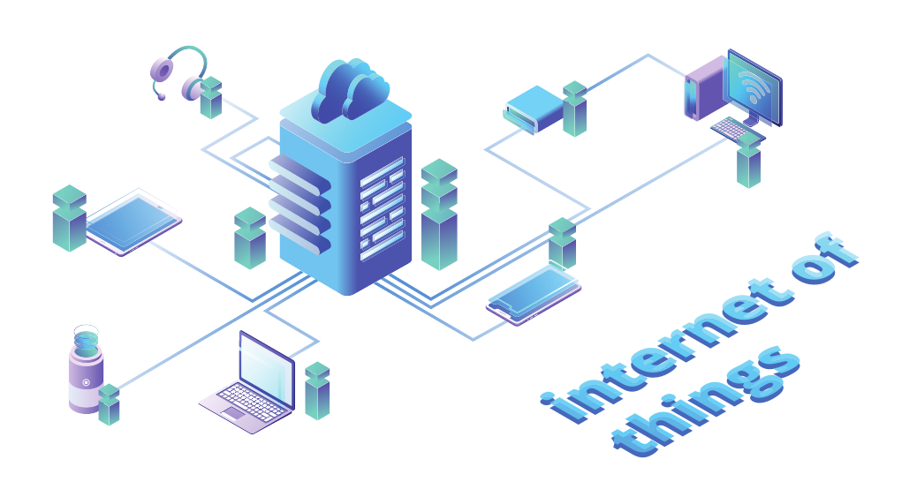
What is IoT?
A system of interrelated computing devices, mechanical and digital machines or objects
That are provided with unique identifiers (UIDs) and
The ability to transfer data over a network
Without requiring human-to-human or human-to-computer interaction.
*Image vectors sourced from: https://www.freepik.com
Notes:
So, the first question that we need to answer before diving into further discussions is, what is IoT?
Well, we have all heard about the term quite a bit and know that it’s an abbreviation for something called the Internet of things. But what’s the actual definition of it?
Wikipedia defines IoT as:
A system of interrelated computing devices, mechanical and digital machines or objects
that are provided with unique identifiers (UIDs) and
the ability to transfer data over a network
without requiring human-to-human or human-to-computer interaction.
Basically, it’s a collective term for all the interconnected smart devices that we surround ourselves with in our everyday lives.

Slide 3



What is Privacy?
A fundamental human right (may or may not be explicitly protected by law)?
A right to be left alone?
“Privacy isn’t really about keeping things private, it’s not about secrets, it’s about choice.”
*Image vectors sourced from: https://www.freepik.com
Notes:
So what’s Privacy?
Is it a fundamental human right (may or may not be explicitly protected by law)?
Or, is it a right to be left alone?
Or is it about something much larger?
Well, it’s a bit more complex than that: Privacy isn’t really about keeping things private, it’s not about secrets, it's about choice.

Slide 4
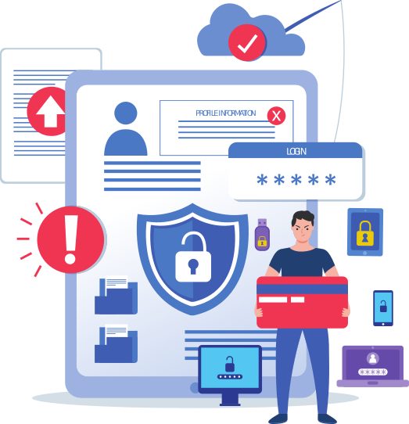
The impact of IoT on Privacy
A world full of sensors talking not just with us but also with the internet.
Making us the product as opposed to be the consumer.
Everyday objects are already becoming smarter and being connected to the network.
*Image vectors sourced from: https://www.freepik.com
Notes:
In recent history Mark Zuckerberg infamously said - “Privacy should no longer be considered a social norm”
Even though it sounds disturbing, alarming even, does his statement have any merit to it?
Consider this:
Surrounded by a world full of sensors talking not just with us but also with the internet, where the data is stored in the cloud from where it might be eventually packaged and sold, are we really the consumers?
Or we being converted into the product that is being consumed in the grand scheme of things?
Everyday objects are already becoming smarter and being connected to the network.
Our computing is slowly diffusing out into our environment.
From what we do online to what we do offline, everything can now be tracked, analysed and packaged into a bundle ready to consumed by the biggest fish out in the open for purposes that might be completely unknown to us.

Slide 5
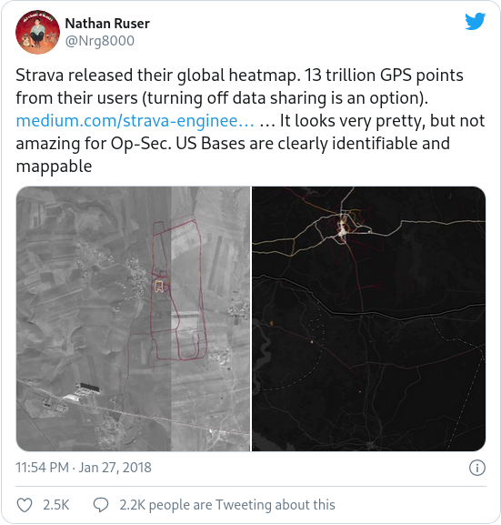
Unintended / Unexpected Consequences!
Countless real-life examples of the potential impact of IoT on privacy.
Recent example:
The Strava Heat Map and the End of Secrets!
*News Link: https://www.wired.com/story/strava-heat-map-military-bases-fitness-trackers-privacy/
Notes:
Last November, Strava announced a big update to its global heat map of user activity.
This map shows over a billion user activities including running and cycling routes of fitness enthusiasts wearing smart watches or other wearable fitness trackers.
It so happened to turn out that somes Strava users appear to work for certain militaries or various intelligence agencies.
Very soon some knowledgeable security experts connected the dots between the highlighted “anonymous” user activity and the known bases or locations of US military or intelligence operations.
Some analysts even went out as far as to say that the data could reveal individual Strava users by name.
Needless to say, the biggest danger here was from potential adversaries figuring out “patterns of life”, by tracking and even identifying military or intelligence agency personnel as they go about their duties or head home after deployment.
These digital footprints that echo the real-life steps of individuals underscore a greater challenge to governments and ordinary citizens alike: each person’s connection to online services and personal devices makes it increasingly difficult to keep secrets.

Slide 6
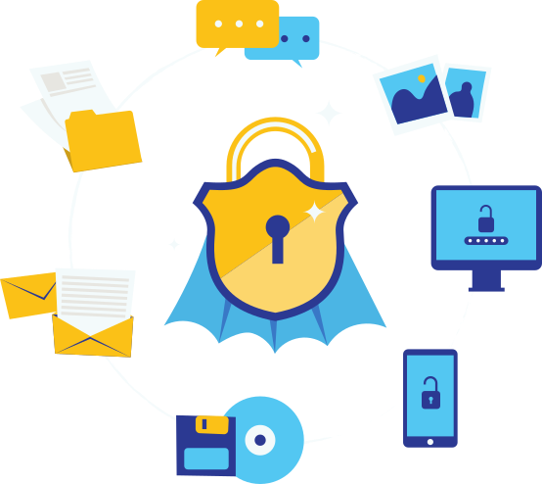
The Deluge of Data
Magnified the threats to data privacy.
Our ability to collect and process data has overwhelmed our ability to protect that information.
No more personal personal spaces since you give them the permission to sell your data.
*Image vectors sourced from: https://www.freepik.com
Notes:
Because a host of convenient smart devices now continuously gather, process, and send data to make our lives more convenient, they have also magnified the threats to data privacy.
Our ability to collect and process data has overwhelmed our ability to protect that information.
Our smartphones, fitness trackers, smart TVs, and all other kinds of smart appliances generate a massive amount of sensitive information, from browsing habits to purchasing patterns to real-time location to personal health information.
It’s no longer just our photos and emails, but also our heart rate, respiration rate, location, how we slept and with whom.
The boundaries of personal spaces are quickly disappearing since we give them the permission to sell our data when we accept their Terms & Conditions without even reading them properly in exchange for free services.
The privacy and attention we’re trading for our “free” services and content is now much more personal.

Slide 7
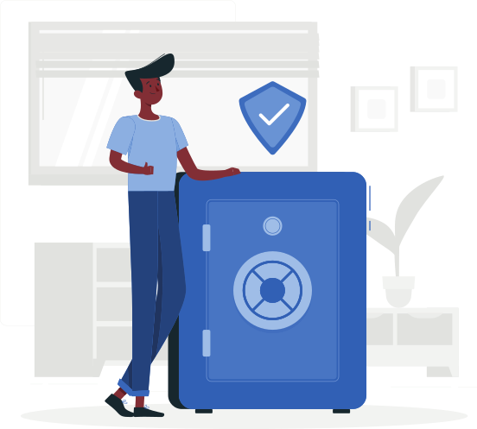
Who owns the Data?
Is the data really anonymous?
Who owns the data being collected by smart devices to make these devices smart?
The footprint your devices leaves on the Internet tells a story.
*Image vectors sourced from: https://www.freepik.com
Notes:
So, the big question here is: Who owns the Data?
Is the data really anonymous? Do we really know what’s being done with this data? Well, It's a matter of ownership.
Who owns the data being collected by smart devices to make these devices smart?
The footprint your devices leaves on the Internet tells a story.
What do you think that story tells? This story is about who are exactly are, including things that even you might not know about yourself.
In retrospect, the responsibility for data privacy doesn’t just talk about keeping your data private, but also about taking ownership of your personal data and what you want to share with the world.
Think about what would be the implication of this unchecked propagation of your private data after a few years down the line both in your personal and private life.
Think about what might happen if someone can actually predict what you are about to do next. What can they do with this data about you?

Slide 8
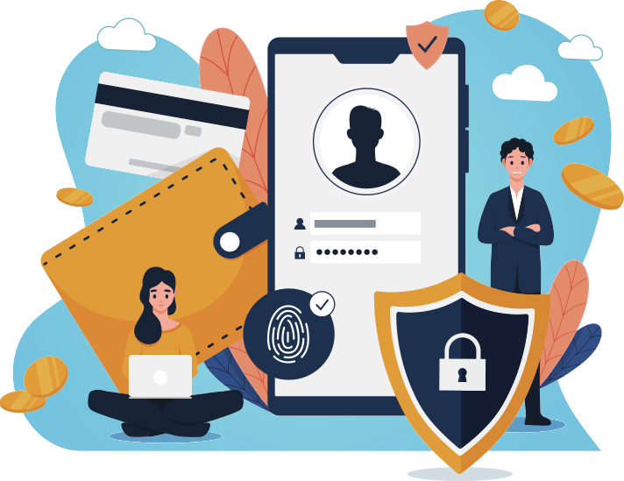
The Responsibility for Data Privacy
Data privacy does not necessarily mean keeping your data private.
It means taking charge of what we choose to divulge about ourselves.
*Image vectors sourced from: https://www.freepik.com
Notes:
It might seem counter intuitive, but data privacy does not necessarily mean keeping your data private — it means taking charge of what we choose to divulge about ourselves.
We now leave a trail of data behind us that grows wider with every smart device we acquire. Billions of smaller and smarter devices will soon paint highly detailed portraits of almost everything we do.
Internet of things (IoT) devices deserve a healthy dose of skepticism when it comes to information security and data privacy.
Installing a small piece of technology within your premises may not seem like a risk management decision, but a poorly configured IoT device can open the door to criminals.
Given that we do not have full control over the devices that require our data to work, we must pay close attention to the data that we share.
Carefully read the end-user license agreement (EULA) before selecting the “Yes, I agree” option.
Protect the electronic doorway to our homes by setting up a secure router. Change the default password of any new IoT device that you set up. In fact, use strong unique passwords for all of your online accounts.

Slide 9

The GDPR - A ray of hope?
Objects should be designed for privacy by default.
Need for an effort to look at the whole lifecycle of a smart device and go beyond the GDPR.
Reliance of legislations on privacy scandals becoming PR nightmares.
*Image vectors sourced from: https://www.freepik.com
Notes:
A great thing that has happened over the course of the last few years is the introduction of the General Data Protection Regulation (GDPR) in 2016 and its eventual implementation in 2018.
It pushed into effect an added emphasis by organizations in general to focus on data privacy and clearly inform consumers about how their data is being used.
In over 30 yrs we have debated over privacy in the internet, with not much success.
Due to a myriad reasons, regulation moves at a snail’s pace.
Ironically, it’s up to CEOs, executives, and employees to reject projects that put profit over privacy.
IoT and connectivity are growing rapidly and to keep up with this pace, privacy regulation strategies need to be applied during the design phase.
From design to manufacture to eventual disposable there is a need for an effort to make more ethical design choices.
Looking at the internet of things we realize that it is still in its infancy.
We can still have a say from the very initial stages about the need for regulation to allow consumers to take control of their data.
It’s time we took a closer look at the whole lifecycle of a smart device and focus upon how we can go even beyond the scope of GDPR and look at the broader scope for data privacy in interconnected devices.
Sadly however, legislation like GDPR rely on privacy scandals becoming PR nightmares for manufacturing companies.
The issue here is that large corporations usually don’t care about consumer data privacy as long as everything is working fine and no one is complaining.
What would it take to convince the decision makers to become a bit more proactive and sensitive towards protecting consumers privacy.

Slide 10

Steps for Reducing Privacy and Security risks
Isolate IoT devices into separate logical segments of the network.
Monitor data flows and watch for unexpected or anomalous traffic patterns.
Ensure that IoT buying decisions are driven by security considerations.
*Image vectors sourced from: https://www.freepik.com
Notes:
Moving forward, we need to be carefully in considering how IoT may intersect with personal privacy and data protection.
To start with, we can take a few small but important steps to reduce risk:
Isolate IoT devices into separate logical segments of the network
Monitor data flows and watch for unexpected or anomalous traffic patterns
Ensure that IoT buying decisions are driven by security considerations, such as the ability to change default passwords, receive and apply patches, and disable unneeded services on any IoT device.

Slide 11
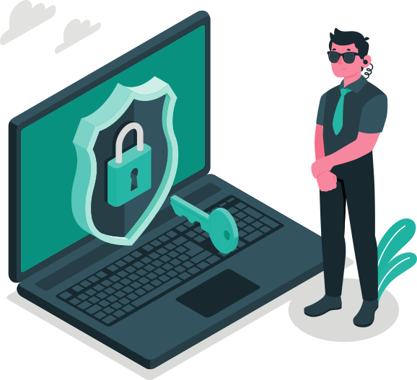
Securing Devices, Not Just Data
The design of IoT technology focuses on convenience, not security.
Managing the risks associated with data collection begins with making the gathered data more secure.
Threats can include hardware vulnerabilities, network threats, ransomware and distributed denial-of-service (DDoS) attacks.
*Image vectors sourced from: https://www.freepik.com
Notes:
The design of IoT technology focuses on convenience, not security, which makes data vulnerable.
Managing the risks associated with data collection begins with making the gathered data more secure.
The time has come to ask what privacy truly requires.
Right now, threats include hardware vulnerabilities, network threats, ransomware, and distributed denial-of-service (DDoS) attacks.
Simple steps like securing a home router can prevent vulnerable devices from becoming compromised.

Slide 12
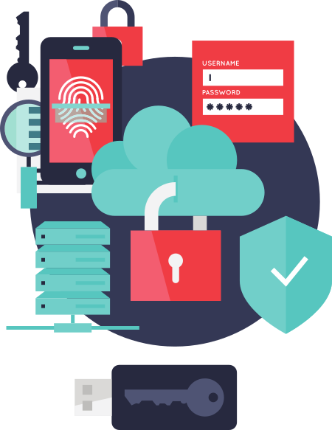
Built-in Privacy and Security for Services & devices
Factory provisioned security keys and secure OTP storage.
Keys as the basis for all encryption, authentication and OTA operations.
Secure-by-Design development approach for IoT core and architecture design.
GDPR compliant architecture and data storage design.
Keys & device provisioning should comply with security and privacy data management guidelines.
*Image vectors sourced from: https://www.freepik.com
Notes:
How can privacy and security be built into services and devices?
The common approach for IoT is to use factory provisioned security keys and store them in some secure OTP area in the device.
These keys are then used as the basis for all encryption, authentication and OTA operations.
IoT core development and architecture design needs to follow a Secure-by-Design approach.
It means that new IoT products need to integrate security into product development as early as possible during the product development lifecycle.
Device architecture and data storage should be designed in such way that enables GDPR compliance.
And finally, keys and IoT device provisioning should comply with security and privacy data management guidelines.

Slide 13
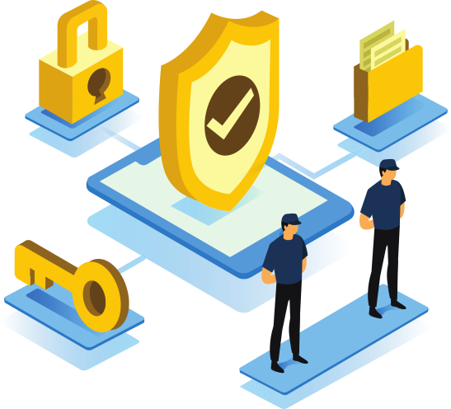
New levels of security and privacy provisions
Early inclusion of security features for data protection architecture design and development.
Unified and well-designed security guidelines to enable encryption on transport layer, security keys, etc.
Compliance with security guidelines and provision of secure interfaces in a proper way.
Inclusion of security and privacy monitoring components into the IoT ecosystem.
*Image vectors sourced from: https://www.freepik.com
Notes:
As the IoT ecosystem evolves and expands, how do we ensure that new levels of security and privacy provisions are implemented?
To make IoT solutions secure and enable privacy, architecture design and development have to include security features at early phases.
IoT systems are distributed, so it’s crucial to have unified and well designed security guidelines to enable encryption for devices on multiple layers, be that the transport layer or security keys or security certificates.
Integration with third-party services may introduce new security breaches.
So it is crucial to check that all components comply with security guidelines and provide interfaces that are secure and could be provisioned in a proper way.
It’s more and more beneficial to include security and privacy monitoring components into the IoT ecosystem.
With AI / Data-driven approach these components enable not only reporting of existing security issues but also can generate some insights to prevent security incidents.

Slide 14

Concluding words..
Privacy is an intimate choice.
Conscious effort is required to tackle privacy concerns.
Focus needs to be on improving privacy and data security in general over convenience.
*Image vectors sourced from: https://www.freepik.com
Notes:
At the end of the session, I just want to highlight that privacy is something that comes to us from within and is an intimate choice.
We need to be conscious about it in all walks of life, whether it’s digital, analog or social.
If we are not conscious enough, we end up paying the price in one way or the other.
Whether we are a consumer or a manufacturer, we need to be conscious about the impact of our decisions on privacy and security in general rather than simply focussing on convenience.

Slide 15
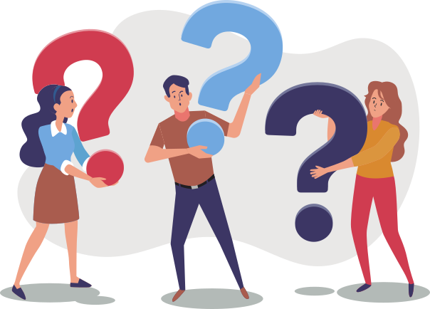
Questions?
*Image vectors sourced from: https://www.freepik.com
Notes:
Any questions are welcome!

Slide 16

@sayak_sarkar
https://sayak.in
Thank you! :)
Notes:
Thank You! :)
You can find more about me on my webpage at https://sayak.in or contact me on twitter at @sayak_sarkar!

